Slide 1

Notes:
Hello everyone, we are the Facecoders. And before you ask, no we do not code with our faces we code the faces. We want to invite you to our final presentation. As you may recall my name is XXX, this is YYY, ZZZ and WWW. We are the Information Technology students at the International Faculty of Engineering. The supervisor of our project is Ph. D. Piotr Napieralski.
Today we gonna present the solution we developed for the problem concerning Affective computing and Emotion recognition.

Slide 2
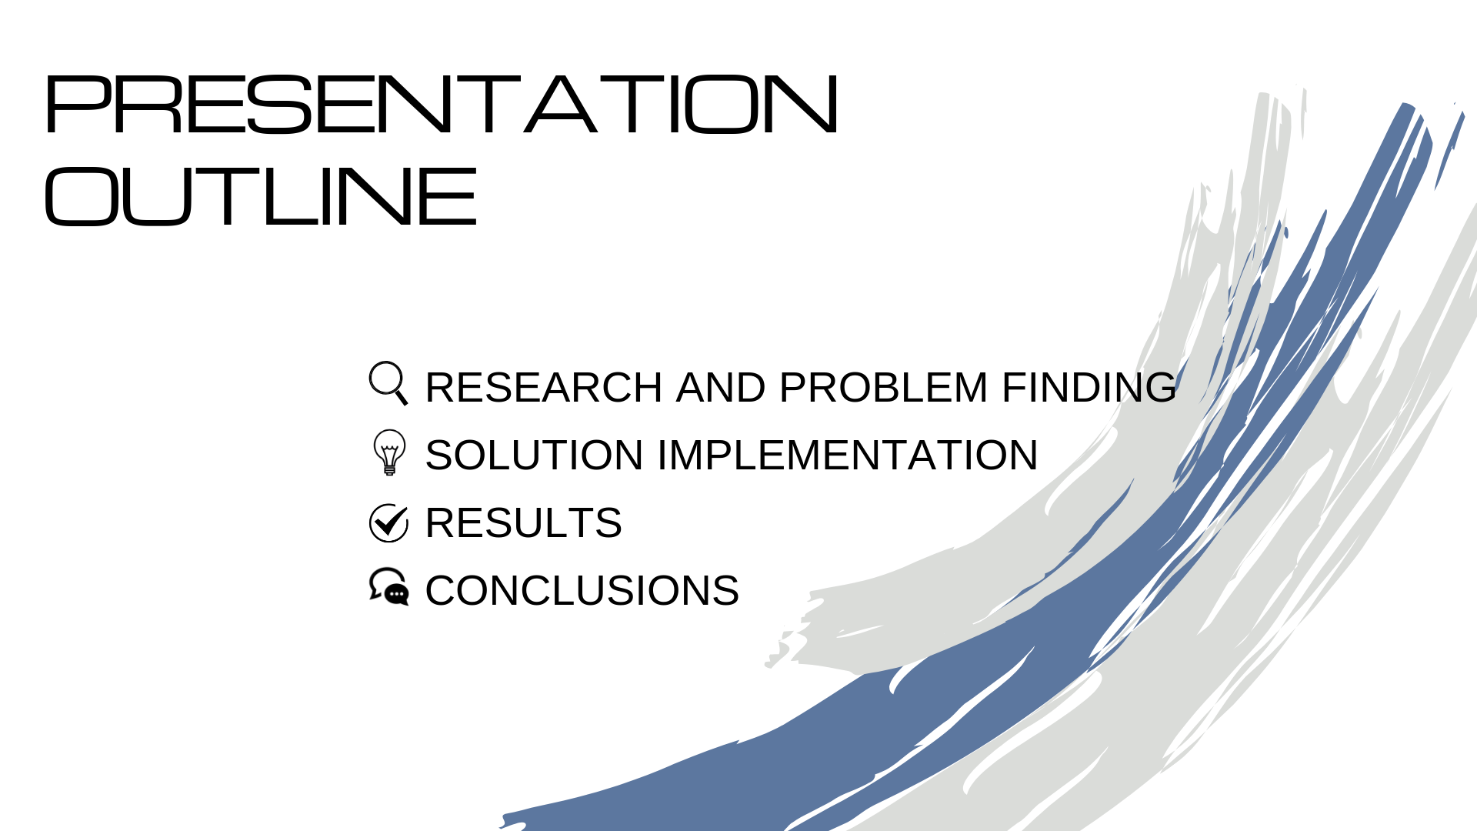
Notes:
Our presentation consists of four significant elements:
Firstly, we will get acquainted with the research done and the problem finding process.
Secondary, look into the solution implementation.
Present the result of our work.
And finally bring down the curtain with the conclusions. /come to the conclusion

Slide 3
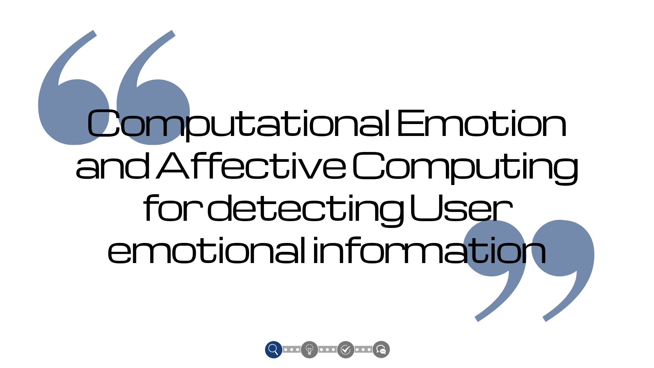
Notes:
The study area that we were working on was “Computational emotion and Affective computing for detecting User emotional information”.
As the PBL course started and we received the topic, we thought of the areas, which might be somehow connected to our topic(it). This (thoughts) lead us to many different directions of the further research.

Slide 4

Notes:
Starting from depression detection, through analysis of advertisement’s effectiveness, we came to the research towards autism therapy.
Dozens of brainstorms were done and even more articles were read. We made a stakeholders analysis, and consulted the issue with a specialist. Applied such methods as ishikawa or “5 whys method”, in order to better recognise the problem and make an appropriate solution.

Slide 5

Notes:
All of it(this) finally lead us to the definition of a problem statement: “Inaccuracy in emotion detection process, due to lack of verification methods”.
As a solution we decided to create an application which can solve this problem by providing an accurate result proved with specialezed equipment.

Slide 6
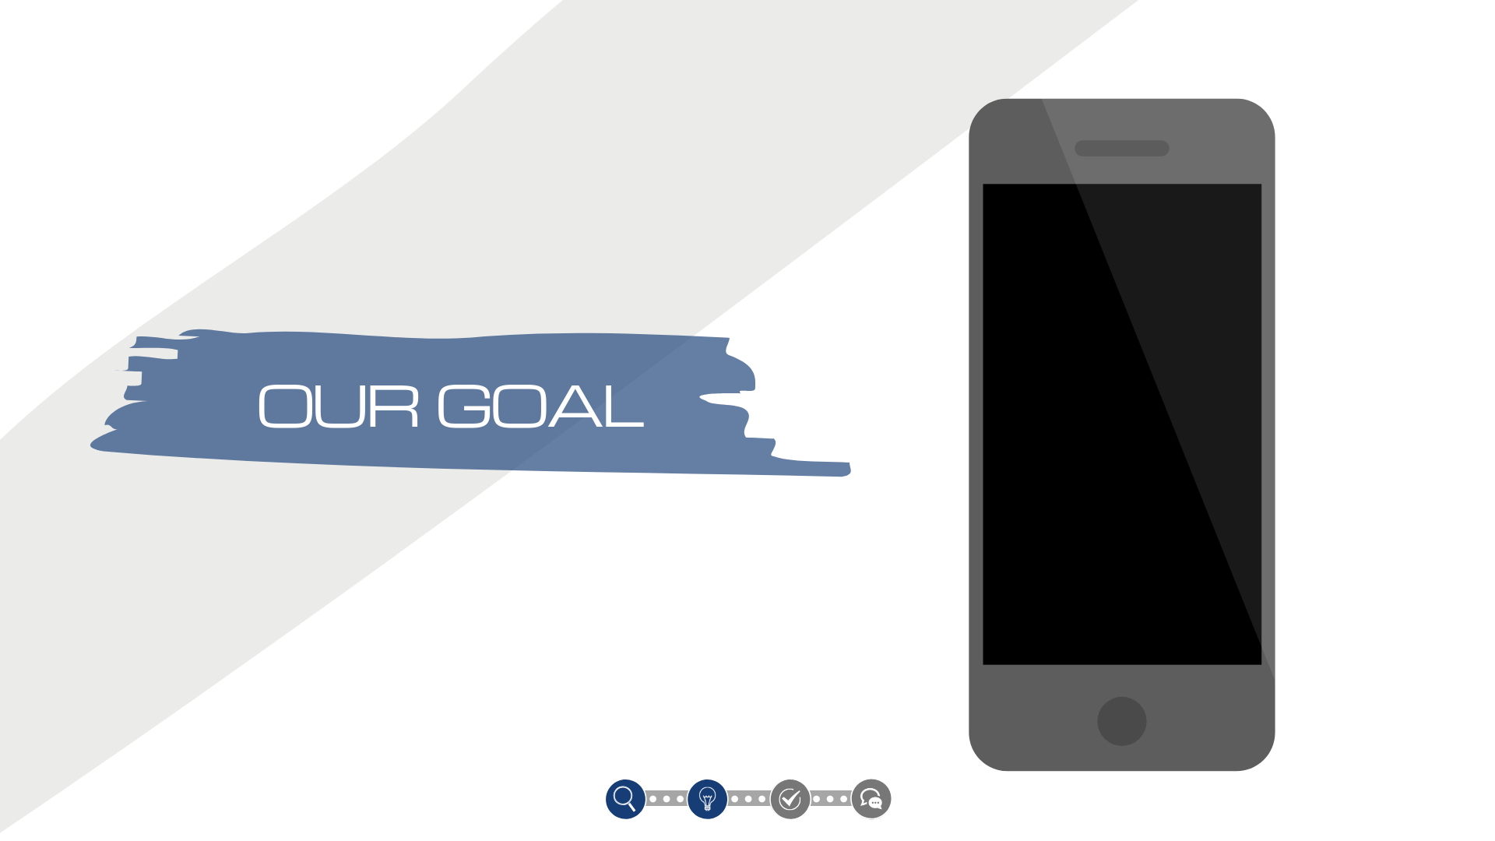

Slide 7
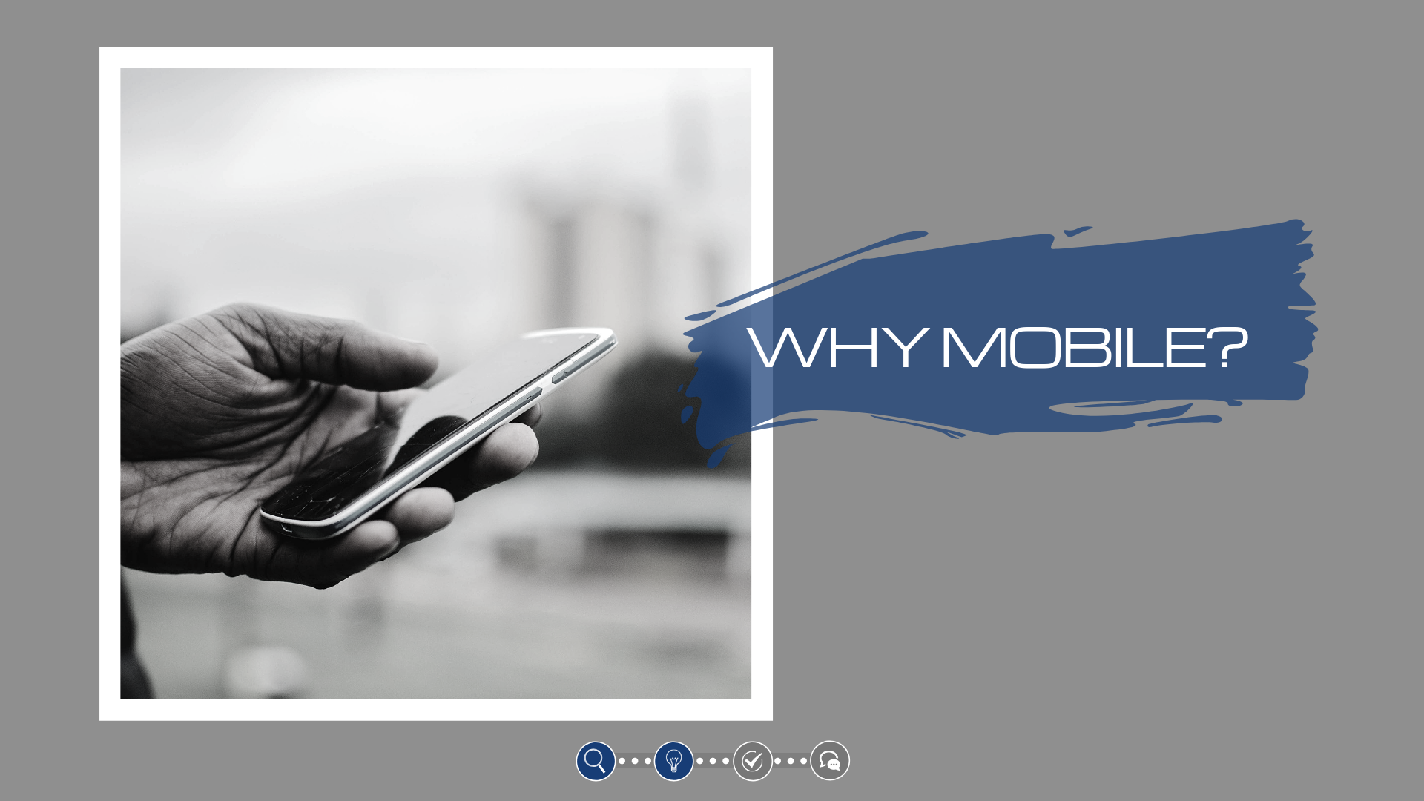

Slide 8
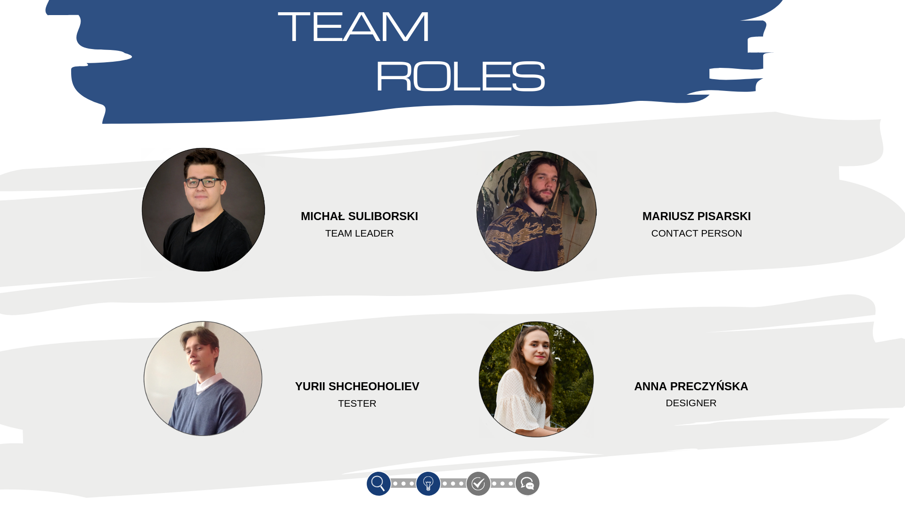
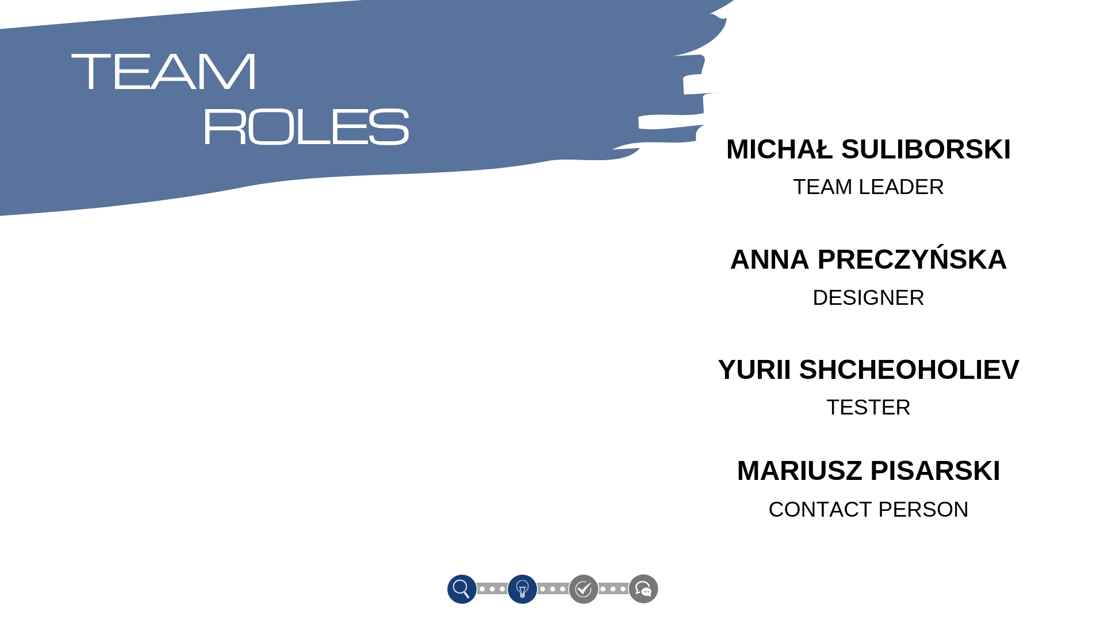
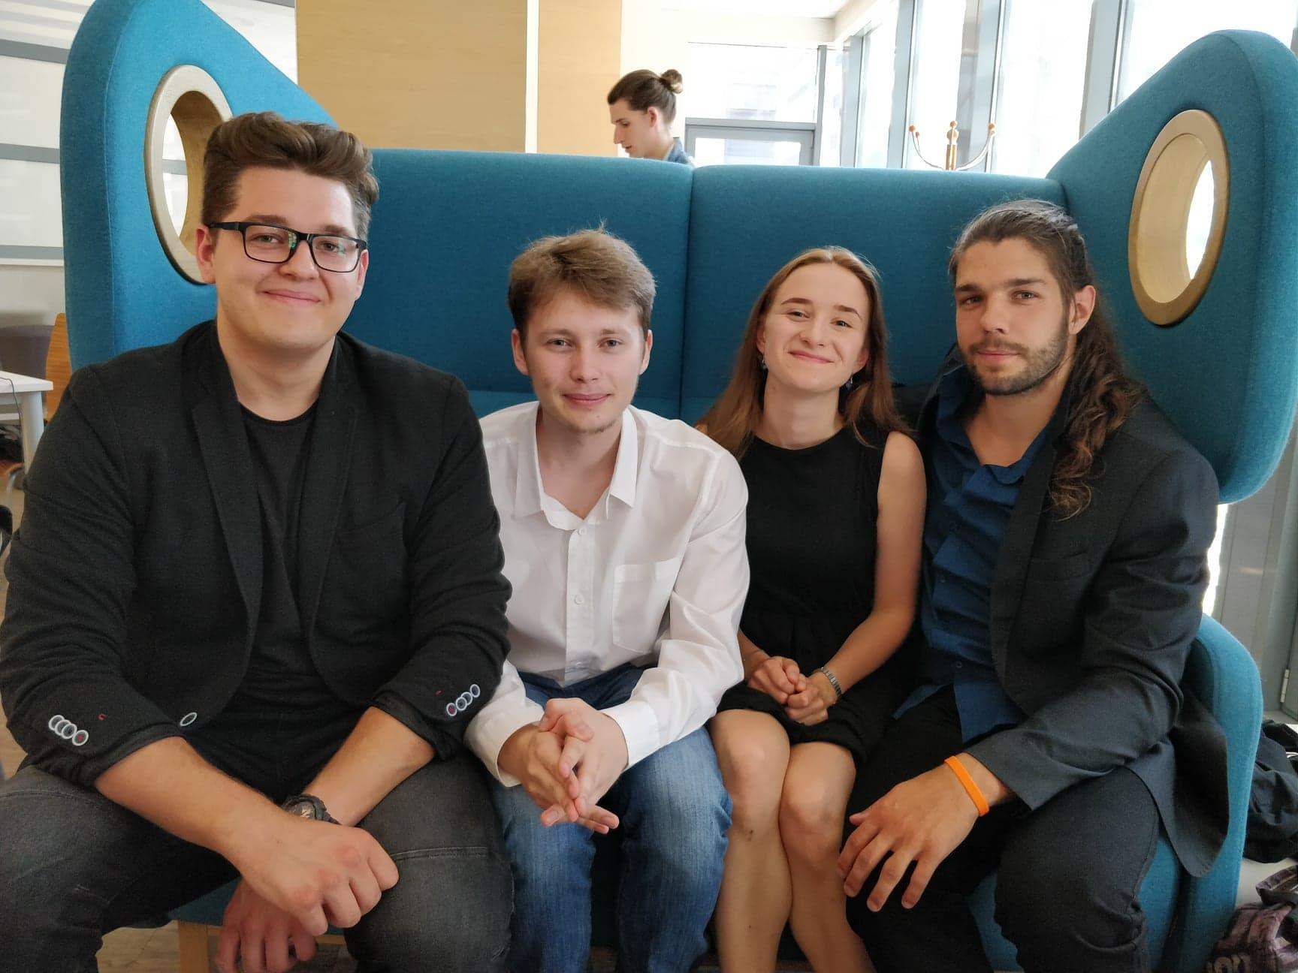

Slide 9


Slide 10
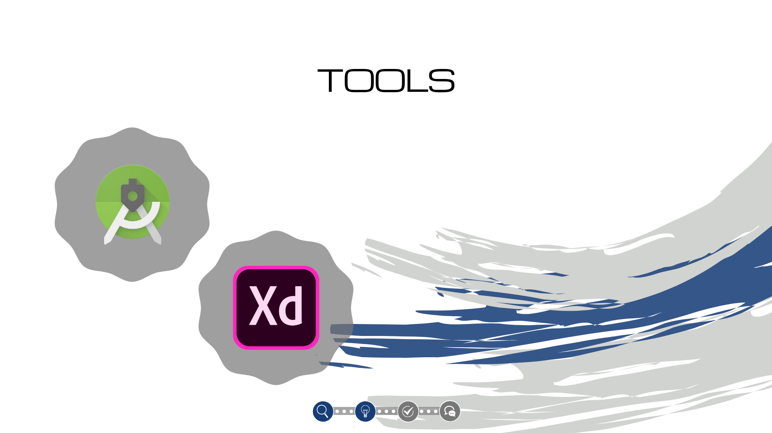

Slide 11


Slide 12

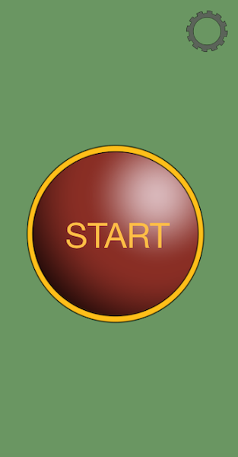
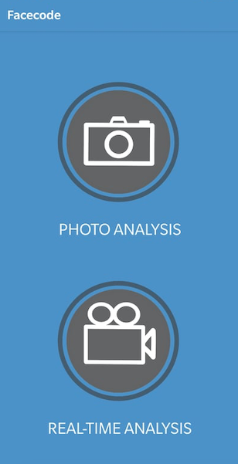

Slide 13


Notes:
database?

Slide 14
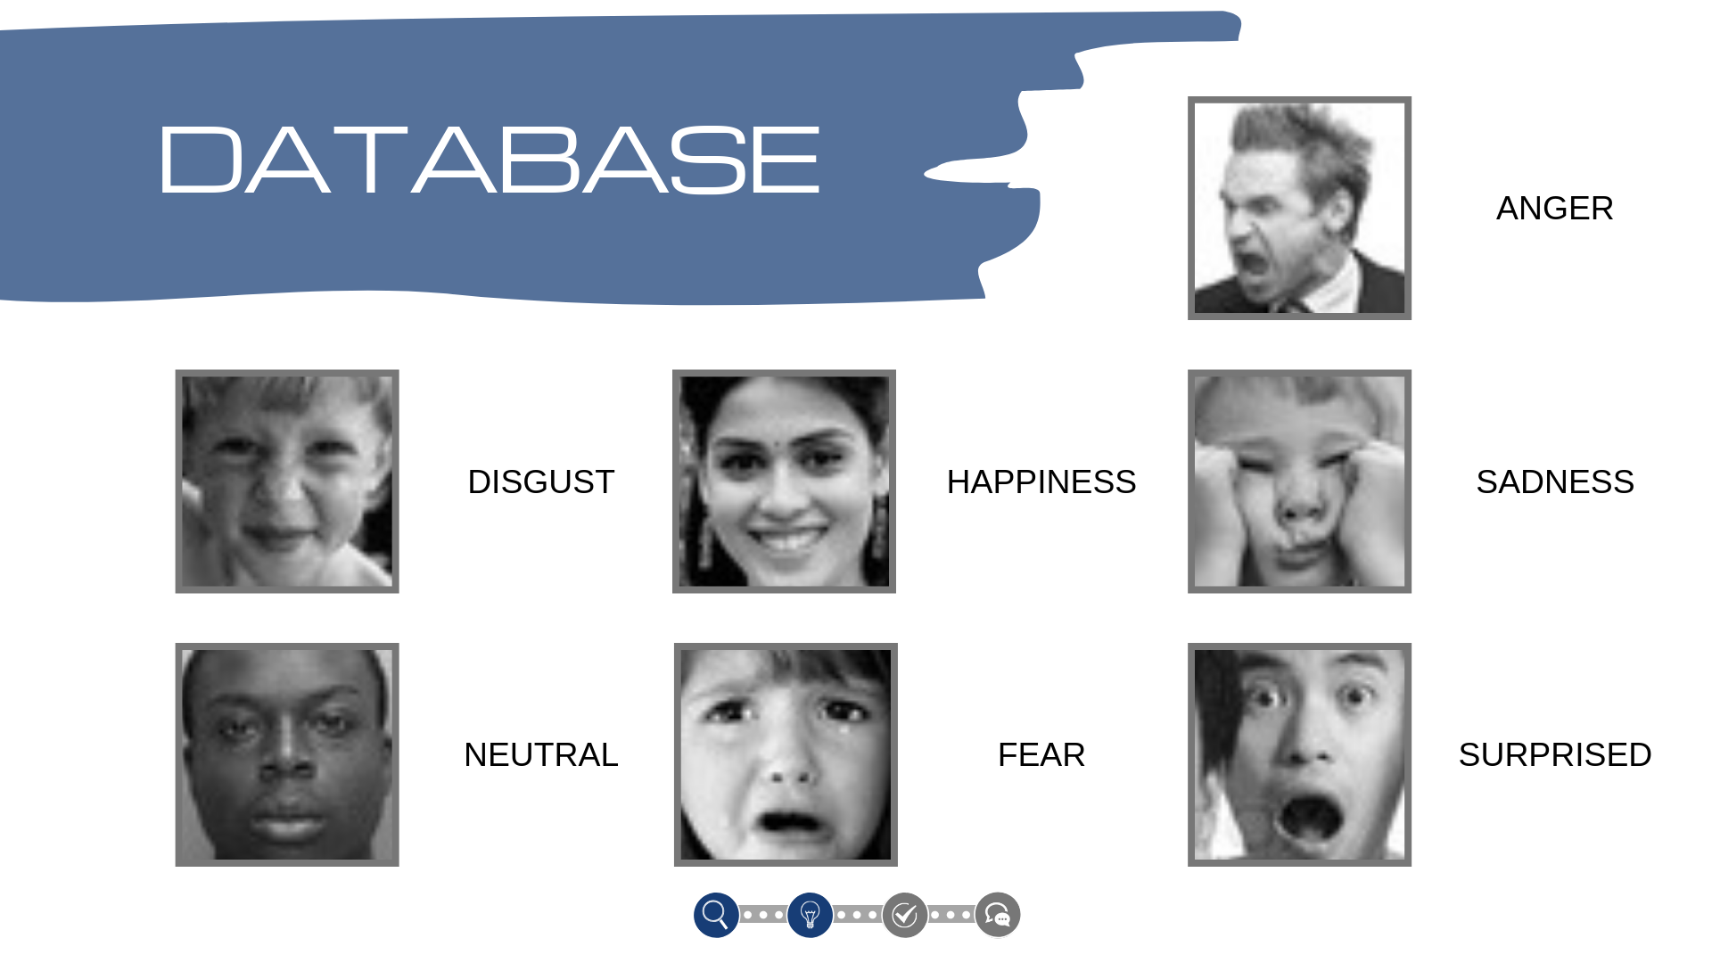

Slide 15
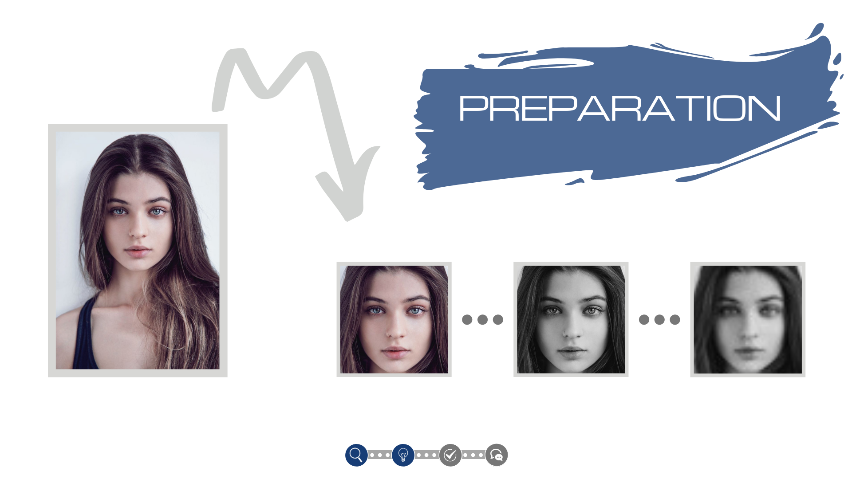
Notes:
deep learning

Slide 16
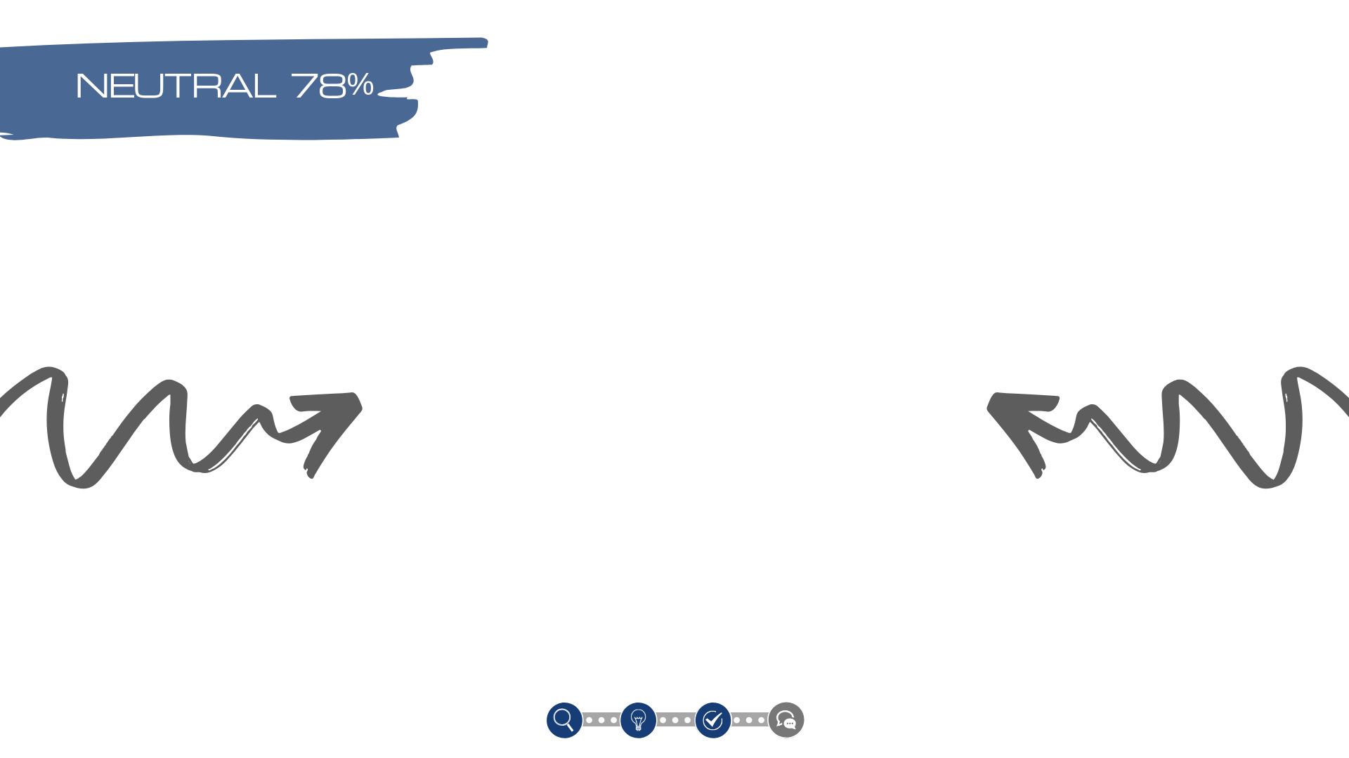
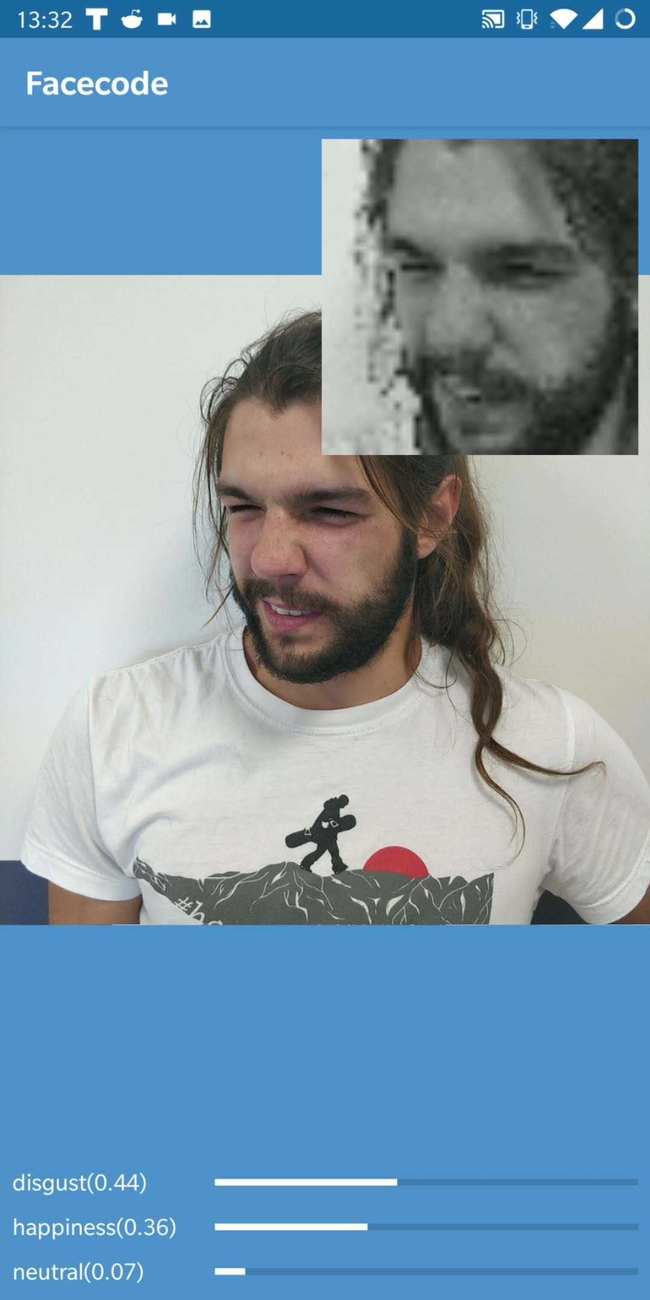
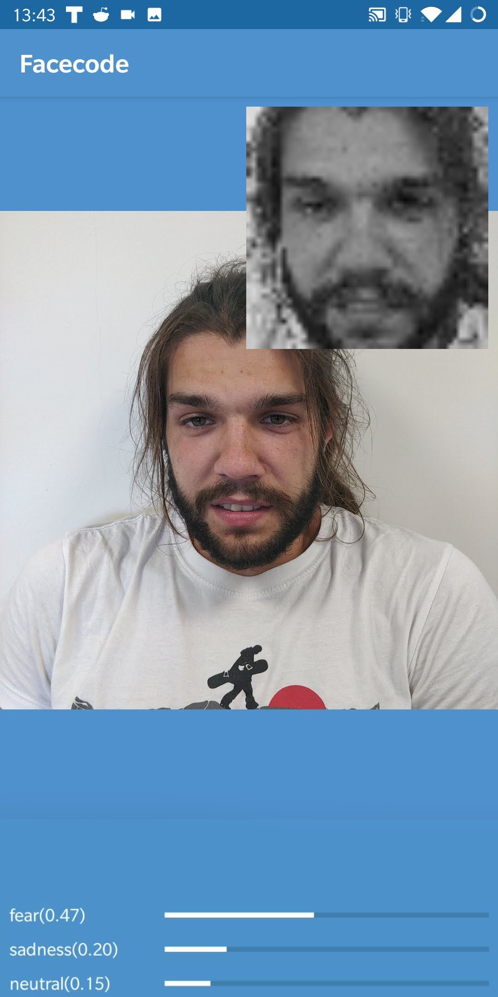
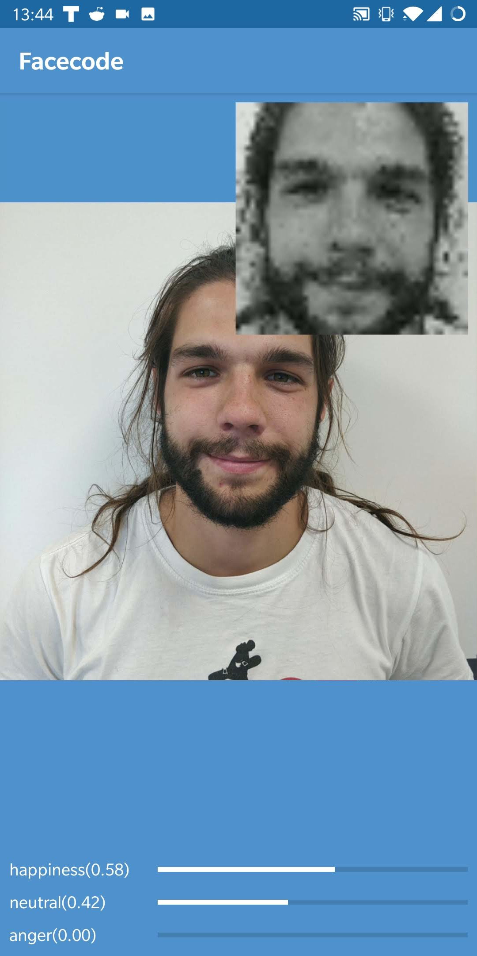
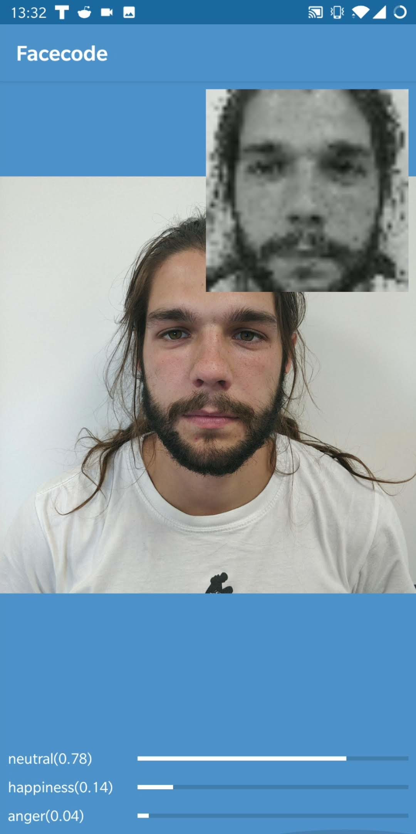
Notes:
app video

Slide 17

Notes:
app video

Slide 18

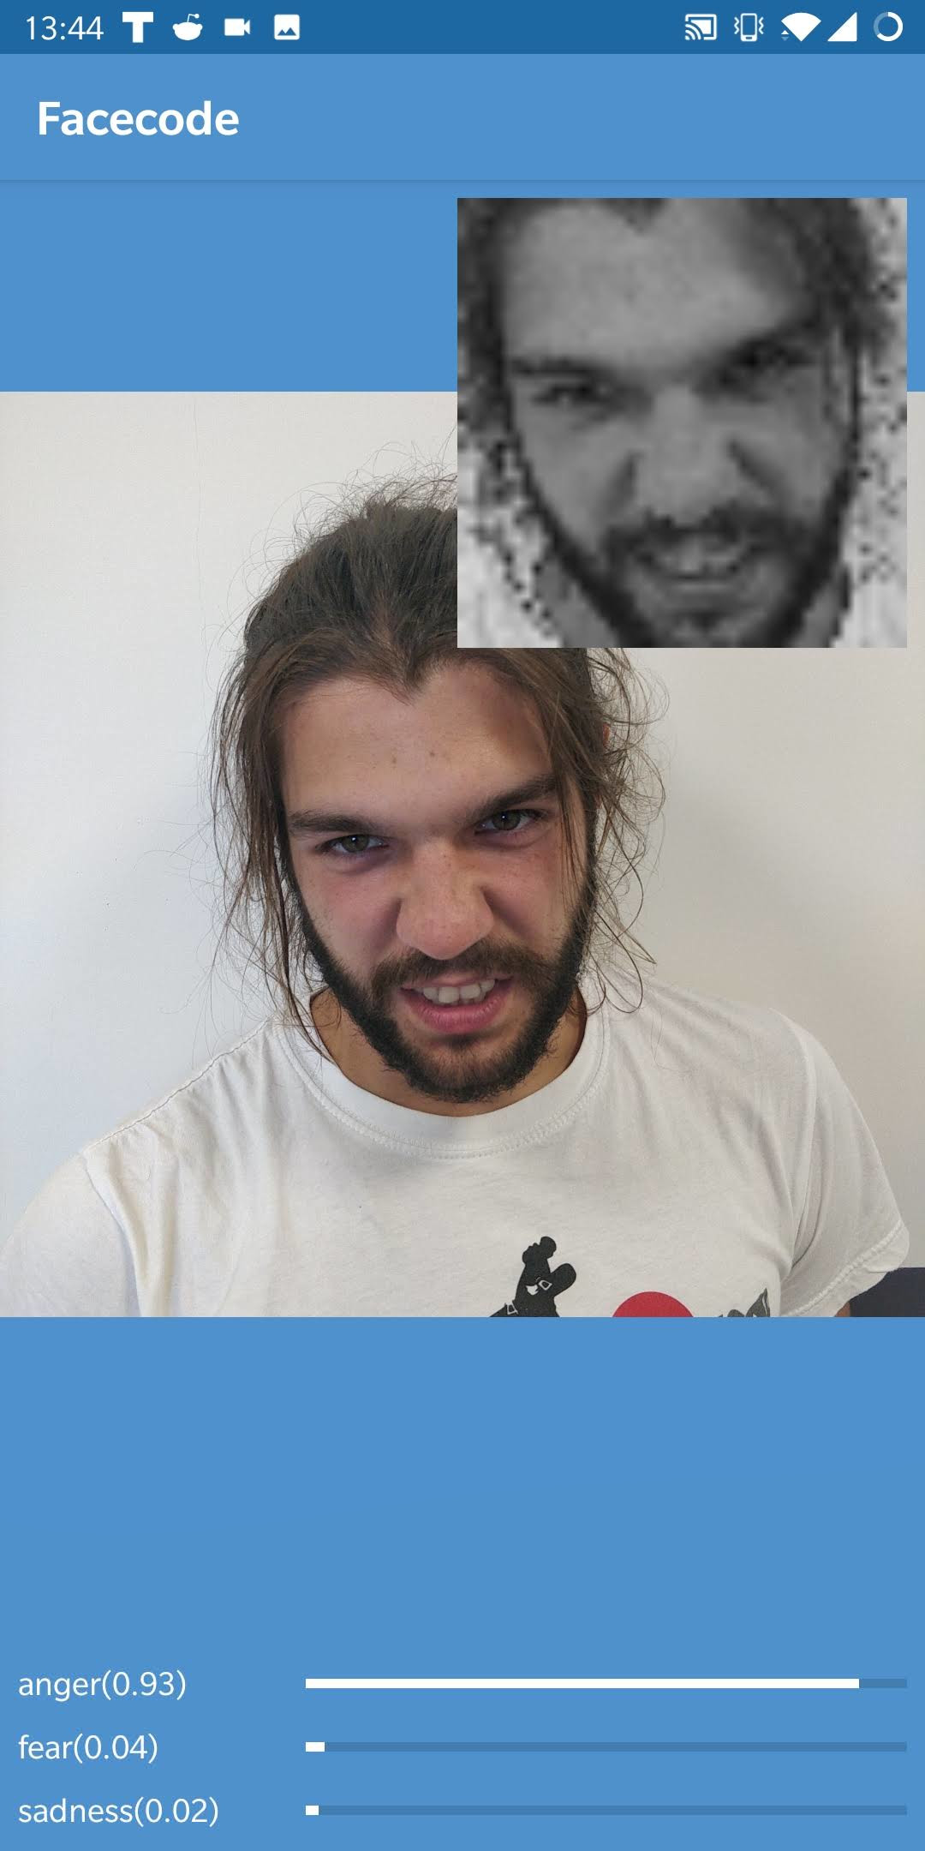
Notes:
app video

Slide 19

Notes:
app video

Slide 20

Notes:
app video

Slide 21

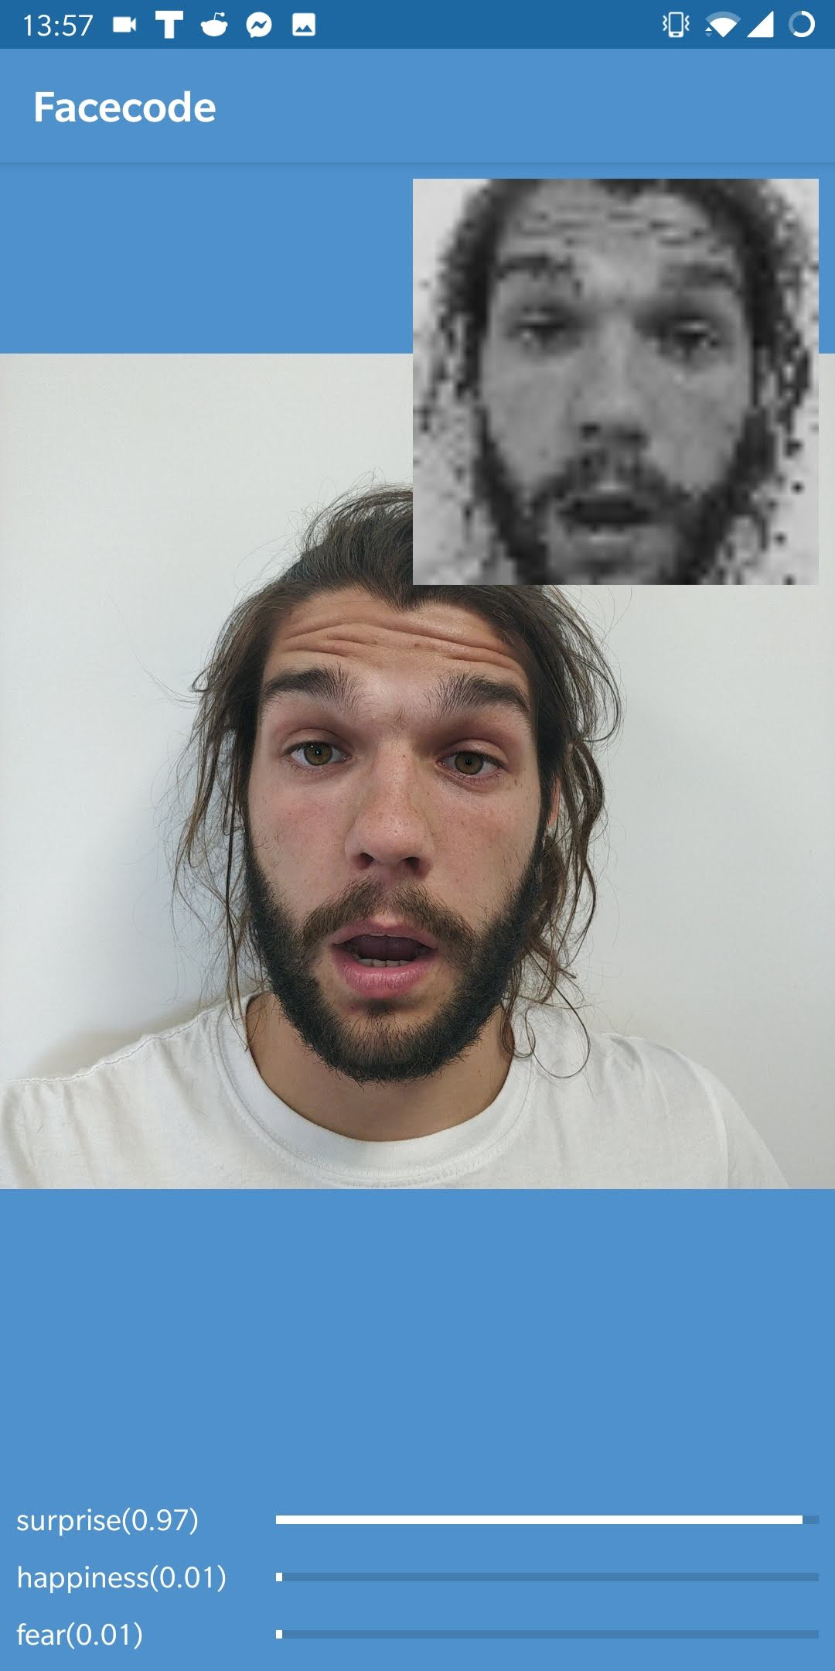
Notes:
app video

Slide 22

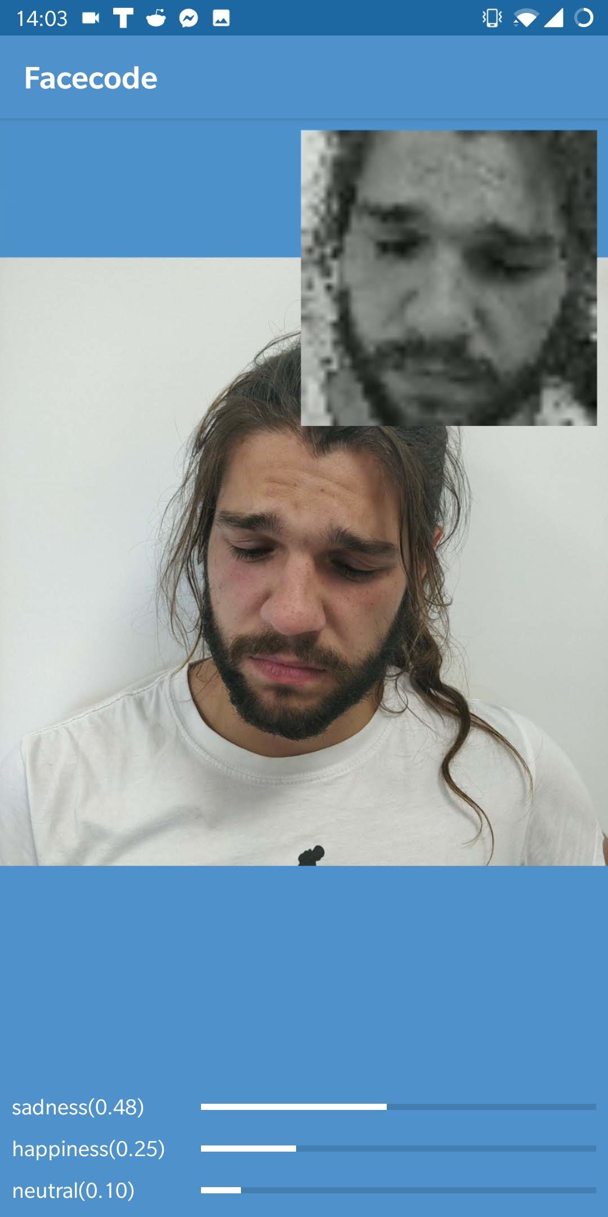
Notes:
app video

Slide 23
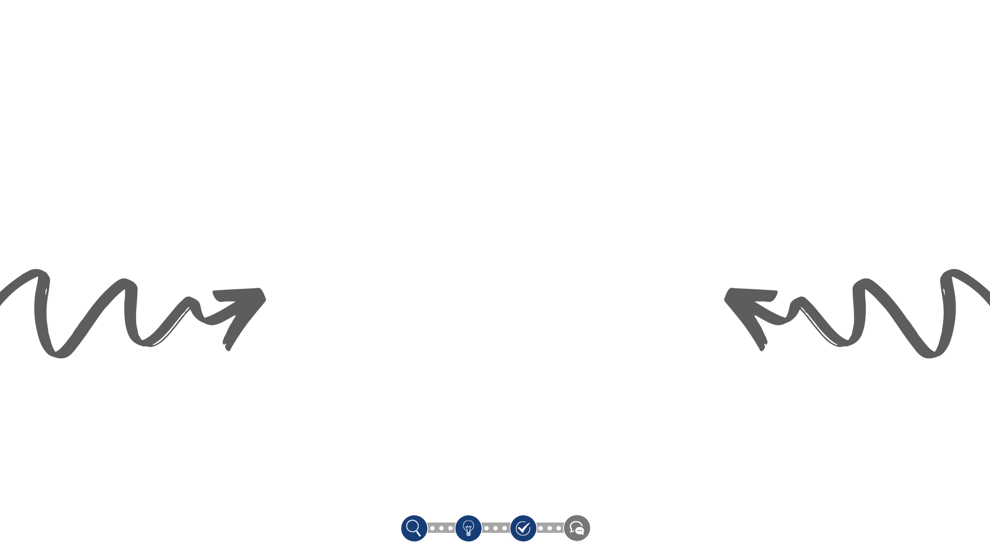
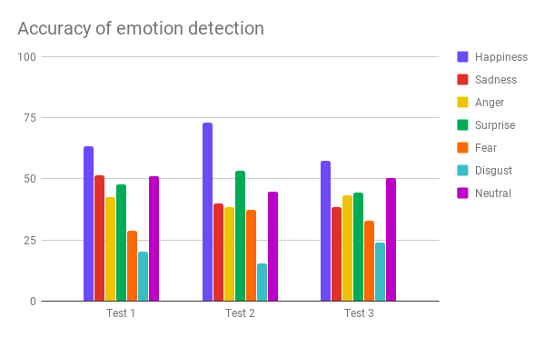
Notes:
app video

Slide 24


Slide 25


